Slide 1

2026

Slide 2

PHOTOGRAPHY & RECORDING DISCLAIMER
Please turn off your camera if you do not want to be included in our social media posts.
Your names will be blurred in any shots we use.
Notes:
1.7.2013
We want to take snapshots of today’s event for our social media, as well as record it for anyone who may have missed out. Please let us know now if you would like to opt-out of being included in those publications
‹#›

Slide 3


ACKNOWLEDGEMENT OF COUNTRY

Slide 4



Scientific research affects every part of the world we live in, but much of its knowledge, innovation, and everyday impact remains inaccessible to the general public.
Complex language and limited communication create barriers between research and the communities it aims to benefit, contributing to misunderstanding and misinformation.
LET'S CHANGE IT! LET'S ENGAGE!

Slide 5

THE MISSION
Develop medical graduate research students into public-conscious scientists, science communicators and diverse leaders.
Inspire the public to engage with science through establishing a baseline of life science literacy and understanding of research & the scientific method.

Slide 6
PROJECT THEMES
Science Communication Training
Building Collaboration and Community
Science Literacy Development
Student Engagement
We make biomedical research understandable, relatable, and genuinely interesting. CoS is aimed at those who feel they missed their chance at accessing science education elsewhere.
Our mentors learn to ditch the jargon and share their science in ways that connect, resonate, and inspire.
CoS brings together researchers and the public to spark conversations, share knowledge, and build trust one project at a time.
We give emerging scientists a unique opportunity to step outside the academic bubble and see the impact of their work through fresh eyes.

Slide 7
PROGRAM OVERVIEW
MENTORS
MENTEES
(You)
Members of the public with limited science education
Workshops to help you pitch and develop your teaching material (mentor documents)
3 fundamental biology lessons that are self-paced and online
Workshops on scientific illustration and visualisation
Tutorials following each lesson to go through the content, questions and feedback
Continuous Support in preparing teaching materials (mentor document)
In-person lab session and Misinformation in Media workshop

Slide 8







COLLABORATIVE PARKVILLE NETWORK

Slide 9
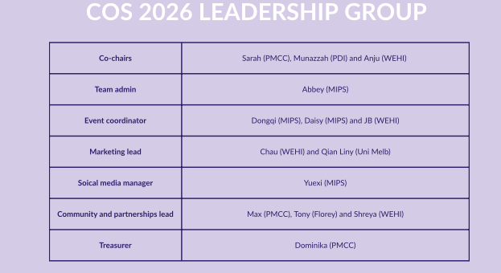

Slide 10

WHAT’S IN IT FOR YOU?
1:1 sessions with sci-com experts
Be part of something new and meaningful
Fine-tune your pitching skills
Meet other scientists across the precinct
Gain mentoring experience
Get cool merch at the end

Slide 11
THE MENTORS (YOU!!)
1
You will receive monthly prep sessions
2
You will be provided with templates and presentation tools
3
You will have flexibility and autonomy with your mentee engagement

Slide 12
THE PROGRAM LEAD-UP
Ideas pitch workshop
Introduce your pitch with other mentors
JUNE
Mentor document prep session
Workshop your main project outline including the background, methods and results/discussion
JULY
Science communication workshop 1
Focus on refining how you communicate your project
JULY
Science communication workshop 2
Focus on visualising your project
AUGUST

Slide 13
What Do You Need To Prepare? (The Mentor Doc)
1
Focused around one key concept
2
Developing a simplified research question
3
Background information in lay speak
4
Simple results - yes/no, graph and etc

Slide 14
What Do You Need To Prepare?
Approximately 20 Slides that can be shared with your mentees:
Cover: Background, Aim, Method Result, Conclusion
In lay language
Simplified Experiment and Results

Slide 15
THE PROGRAM
WELCOME EVENT
Introduce yourself at the Welcome event - 11th September
SEPTEMBER
MENTOR/MENTEE SESSIONS
Meet with them once a week, for three weeks
Communicate and organize meetings yourself (Online/in person)
OCTOBER
FINAL PRESENTATION
Present with them at the presentation event - early November
NOVEMBER

Slide 16
THE MENTEES
1
Mentees will be selected from lay groups :
General public,
Institute professional staff,
Consumers
2
Mentees work in pairs (some triplet groups)
3
Mentees will have various levels of scientific knowledge, communication skills and presentation competence

Slide 17

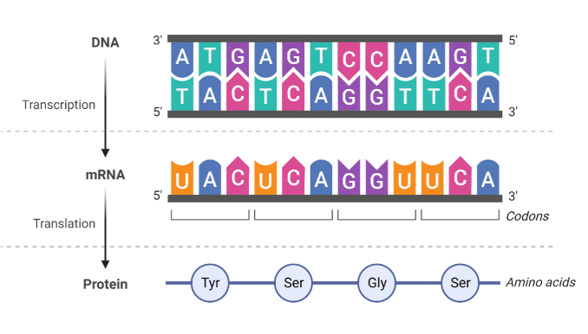

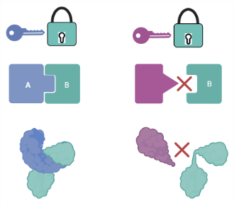
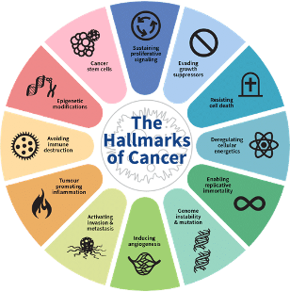
PRE-LEARNING FOR MENTEES
LESSON 1
An intro to DNA
and the central dogma
LESSON 2
Protein structure and function
LESSON 3
Biological basis of disease mechanisms and treatments e.g. cancer

Slide 18


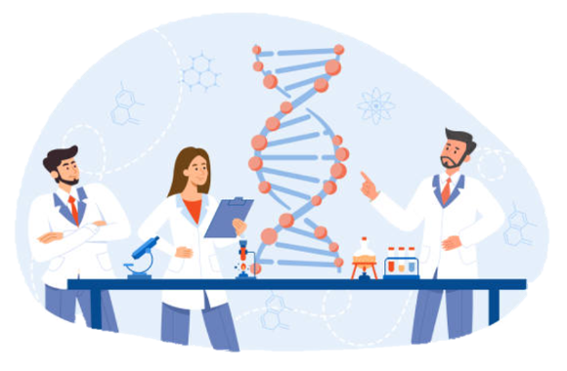

MENTORSHIP SESSION
Week 1:
Introduction to your topic and prepared information/"literature",
e.g. a lay document with sources.
Week 2:
Your methods used. e.g. a simplified set of methods you can use to generate data.
Week 3:
Curated results e.g. very simply presented results that show a clear "yes/no") - a cell with a stain vs control, a protein binding curve vs no binding.

Slide 19
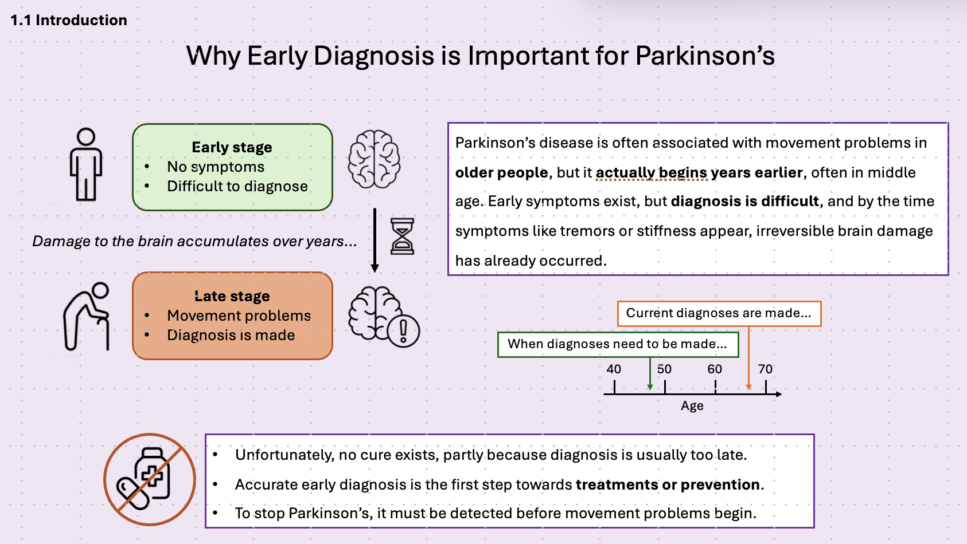
EXAMPLE
Mentor Doc Excerpts

Slide 20
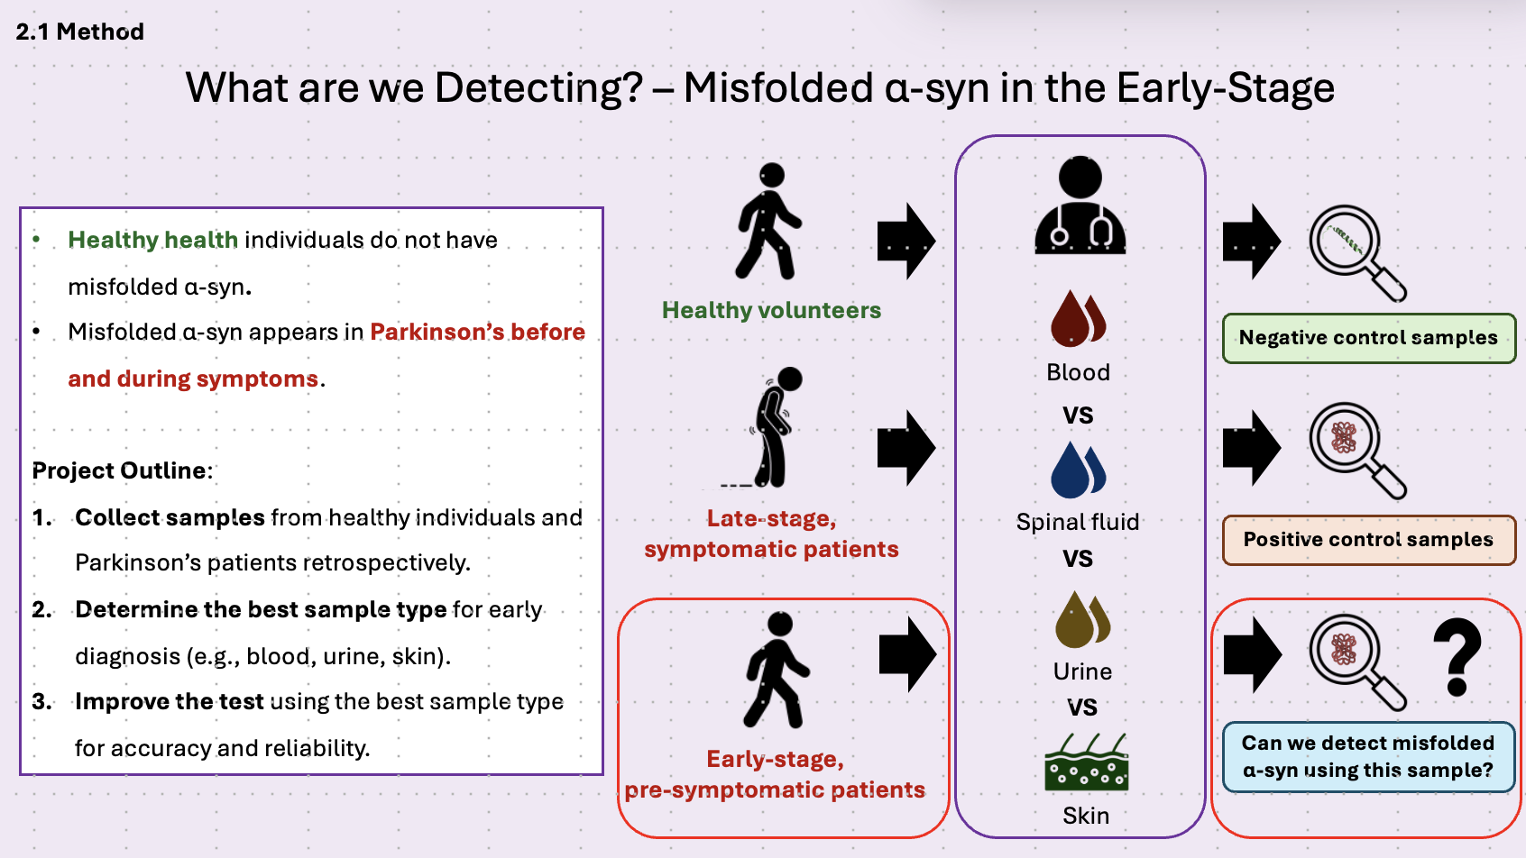

Slide 21
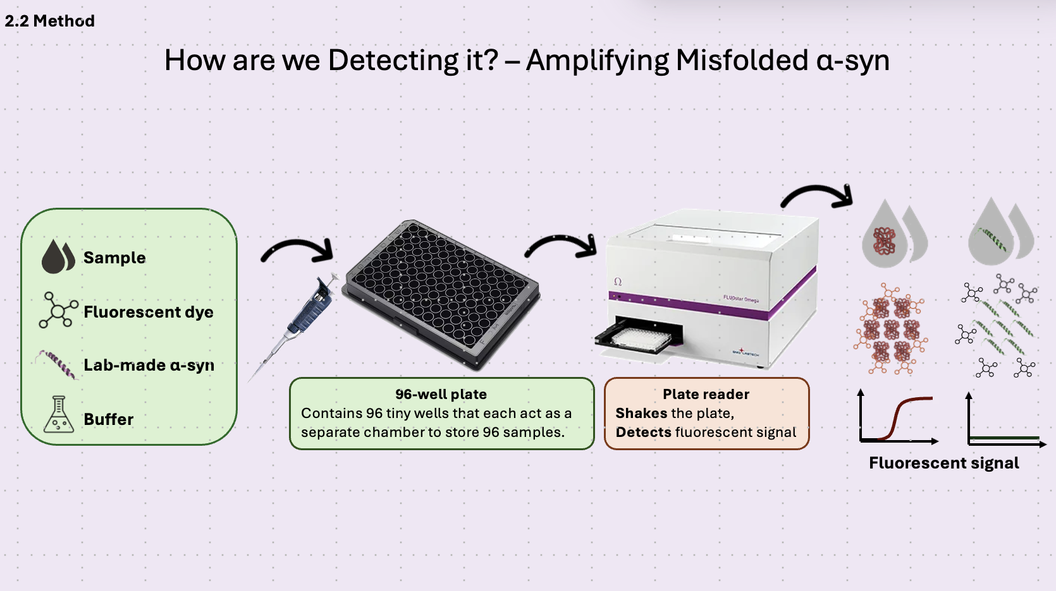

Slide 22
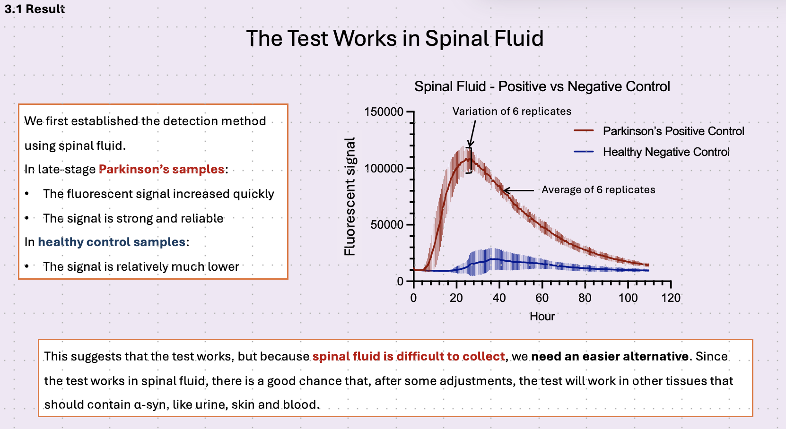

Slide 23
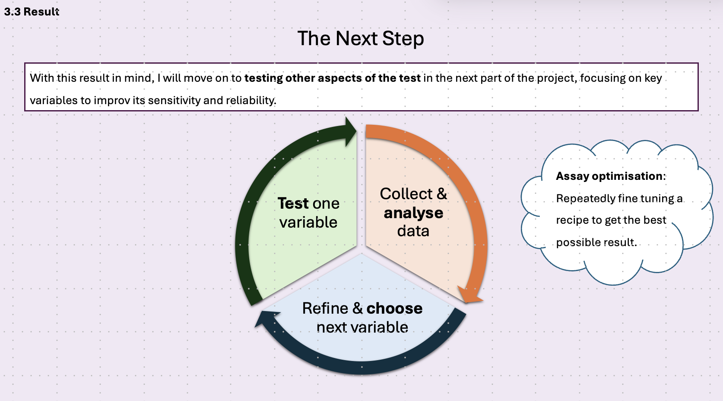

Slide 24
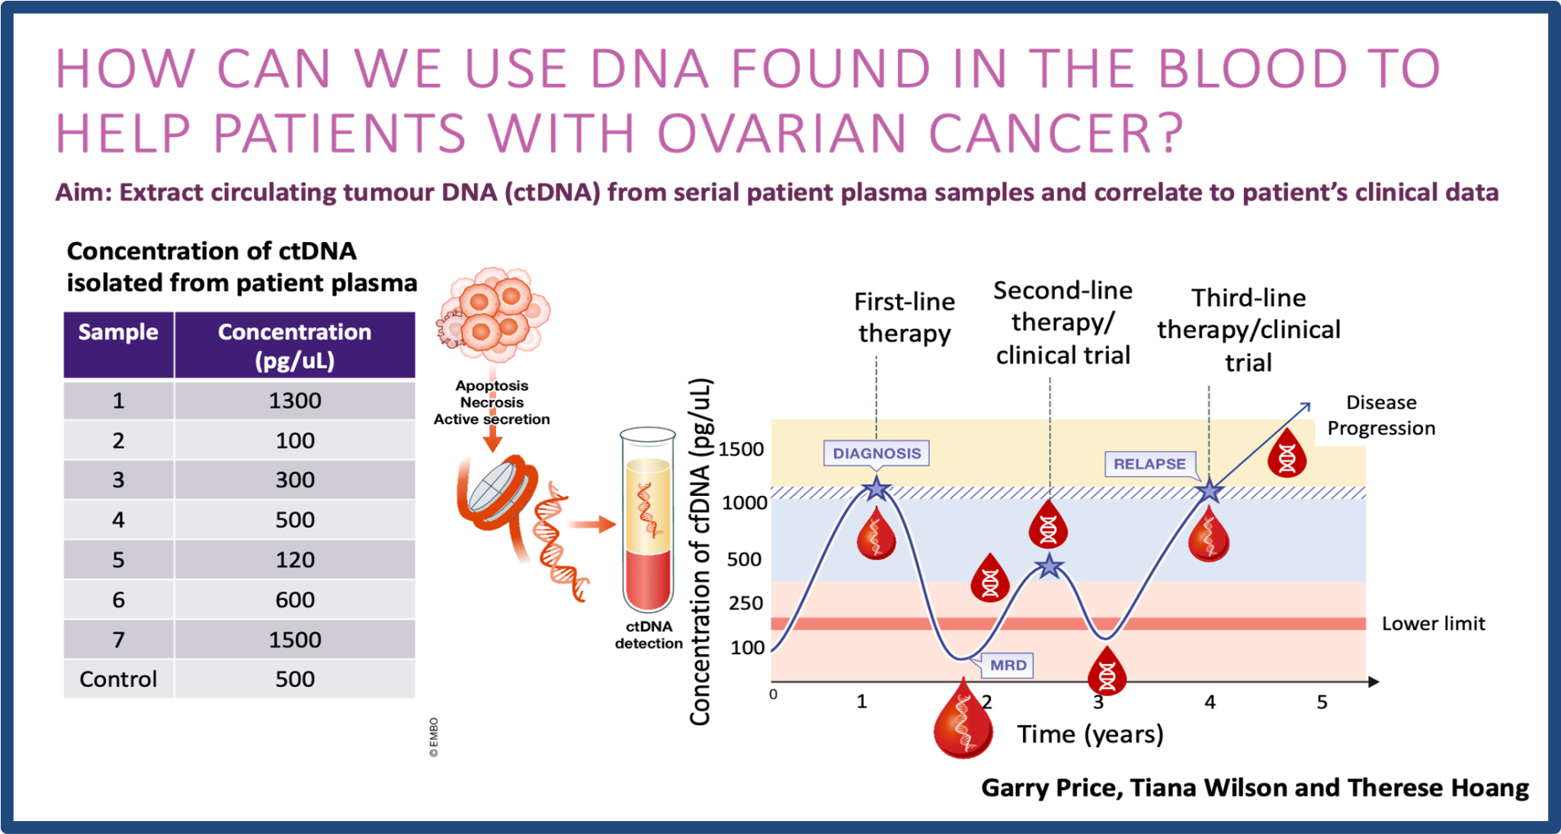
EXAMPLE
Final Presentation Slide

Slide 25
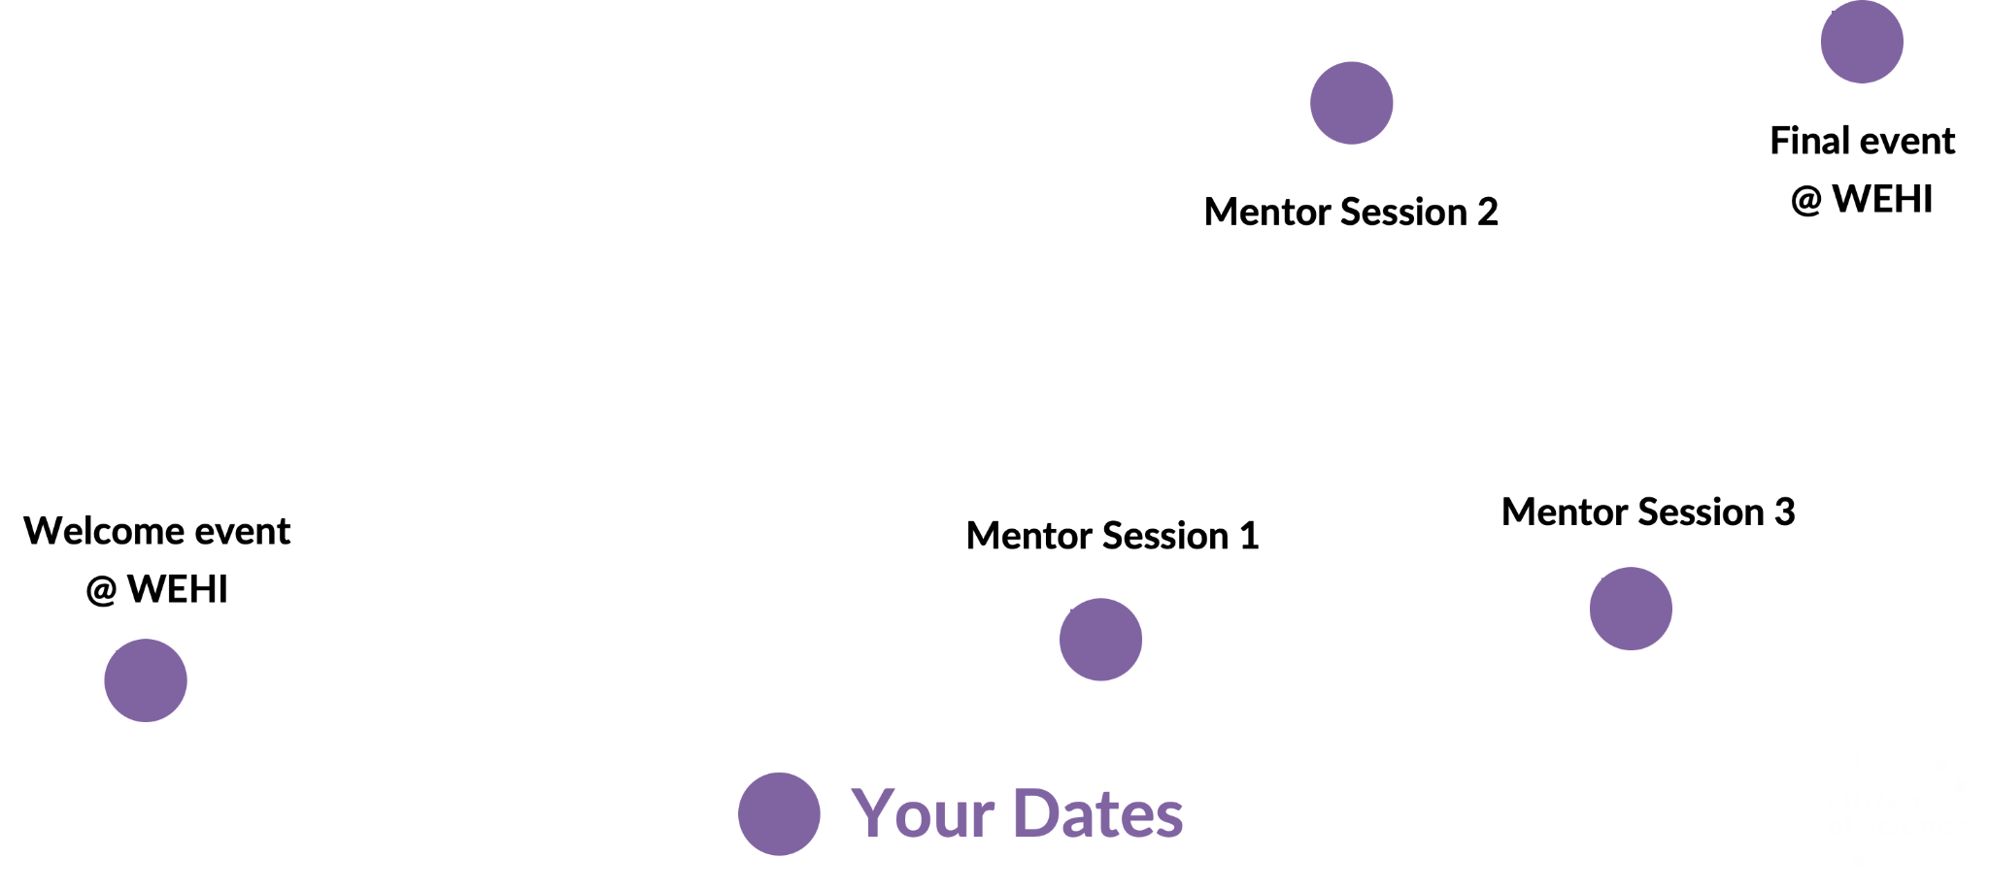
TIMELINE
5
3
September
October
November
4
2
1
Notes:
Timeline for mentor

Slide 26
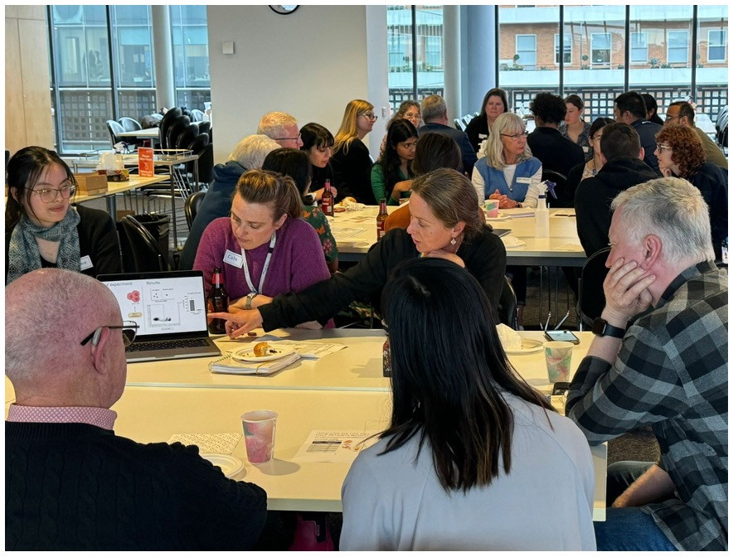
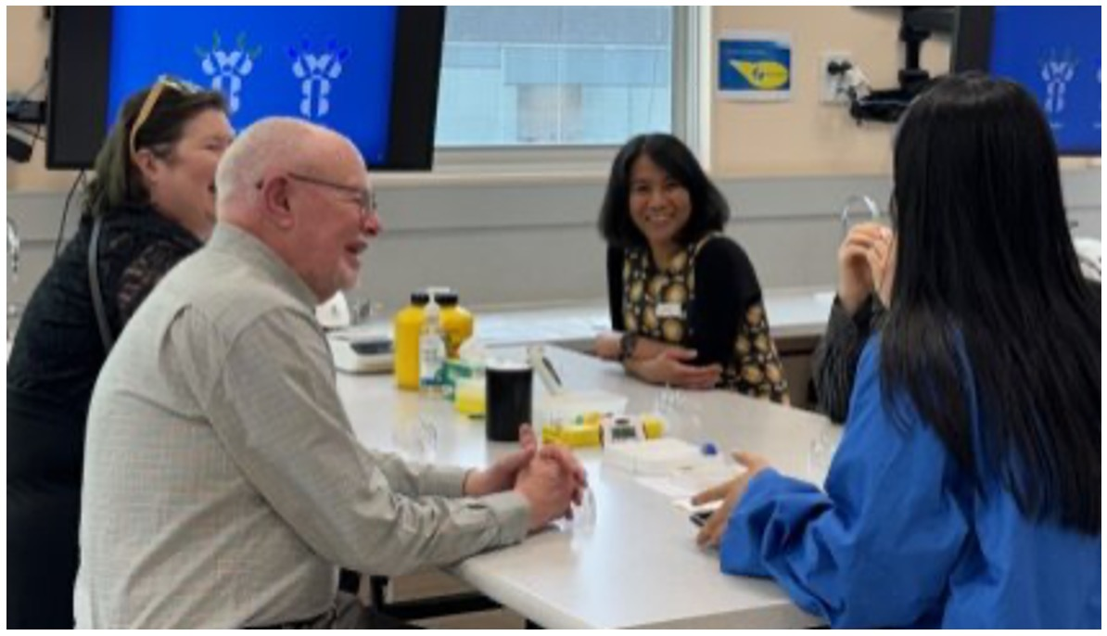
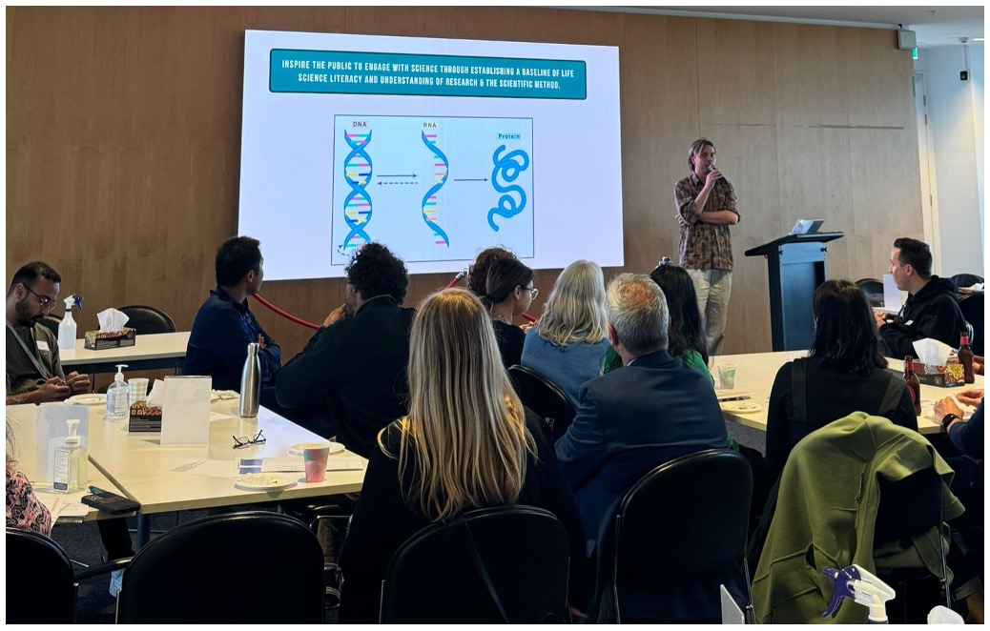
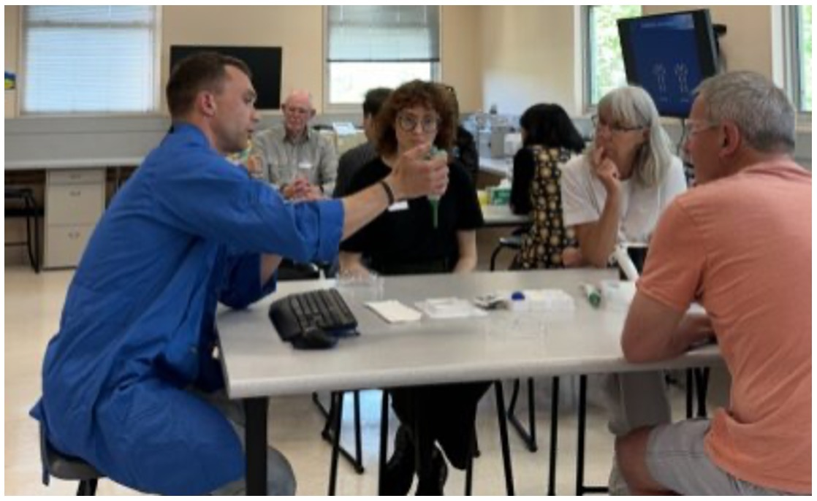

Slide 27
Hear From a Past Mentor?

Slide 28
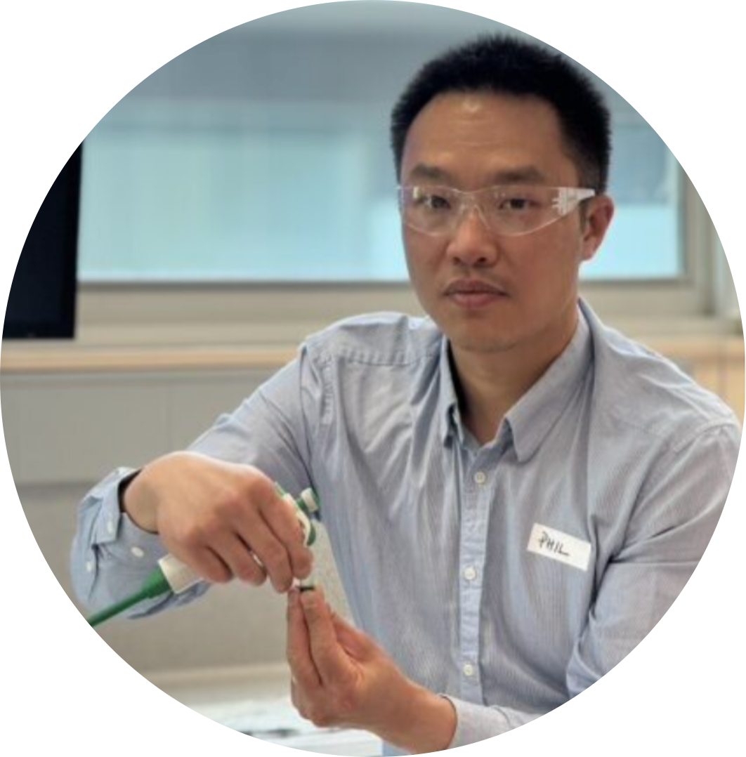

MENTEE TESTIMONIAL
“The Citizens of Science program was fantastic. The tutorials gave me an invaluable insight into the science that underpins medical research and biopharma therapies, and working with my mentor to understand his research project showed me the strong capabilities of the CRISPR gene editing tool in advancing cancer drug development.”
- Phil, WEHI’s legal team

Slide 29
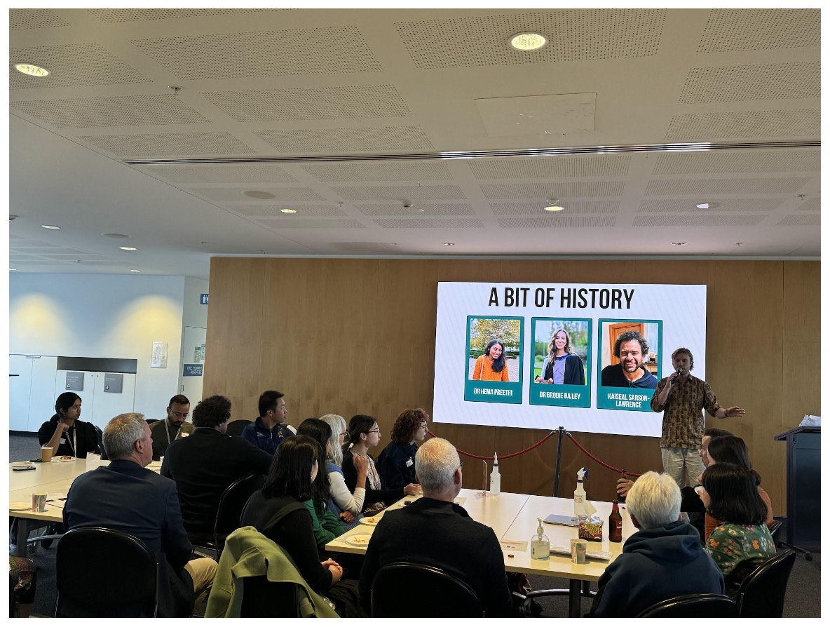
BE PART OF THE STORY!
First mentor prep session - June
https://citizensofscience.org/
Notes:
We will follow up with an email and another google form - more specific about your project and pitch by next week.
There are limited mentor positions so if you’re keen to participate then please reply to the follow up email as soon as you can. Please also consider your availabilities during the year, we understand that everyone’s busy but we want you to make the most out of the program in-person so if you know you won’t be around at the end of the year then shoot us an email and we can pop you on a waiting list for next year’s program.

Slide 30
TIMELINE
5
3
Module 1
Module 3
September
October
November
Module 2
4
2
1

